Slide 1
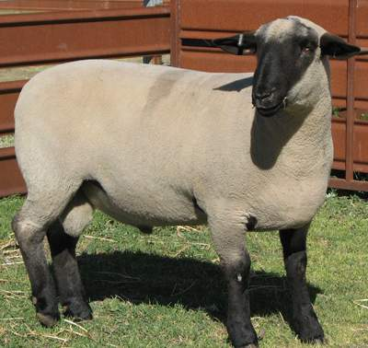
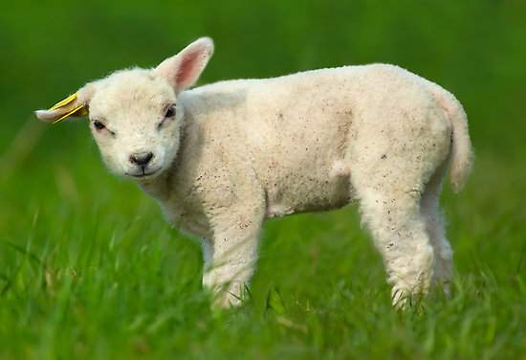

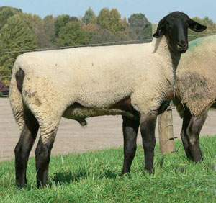
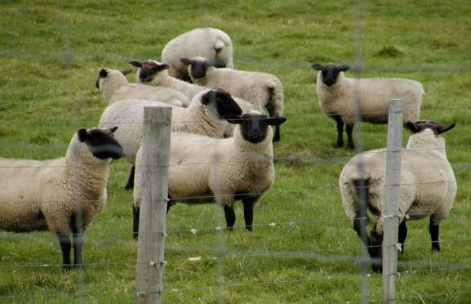

Slide 2
Objectives
Terminology
Breeds
Management Practices
Feeding and Nutrition
Animal Behavior
Animal Growth and Development
Animal Health
Evaluation

Slide 3
Terminology

Slide 4
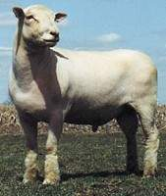
Ram
A male that is sexually mature
Young males are called ram lambs

Slide 5
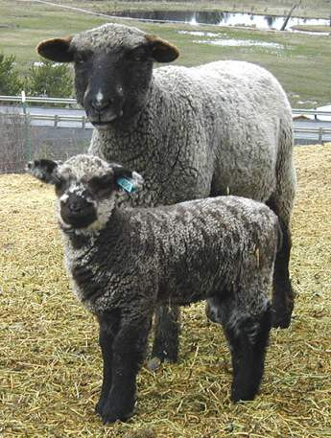
Ewe
Sexually mature female
Young females are called ewe lambs

Slide 6
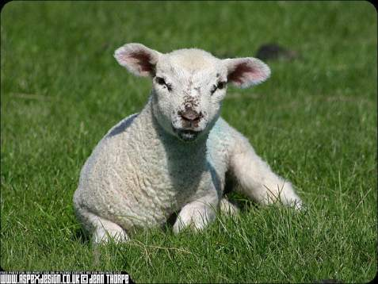
Lamb
Young female or male

Slide 7
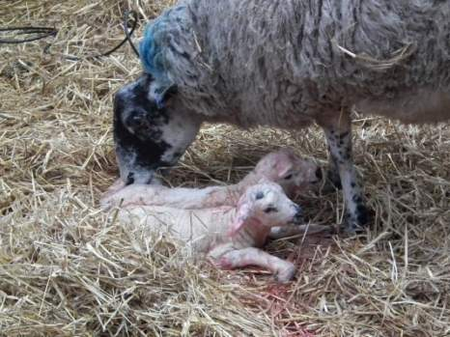
Lambing
The act of giving birth

Slide 8
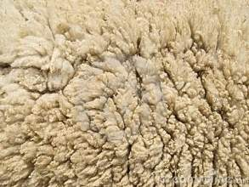
Fleece
Wool of a sheep

Slide 9
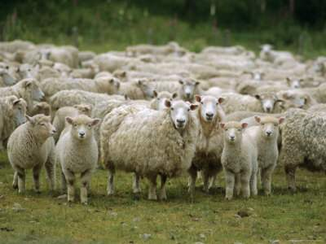
Flock
Herd or group of sheep

Slide 10
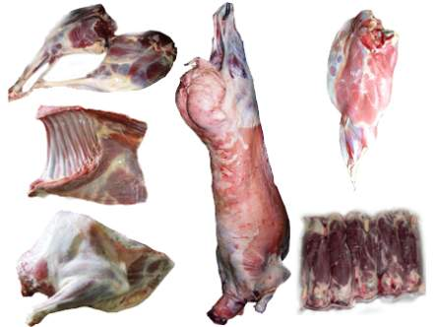
Mutton
Meat from sheep over one year of age

Slide 11
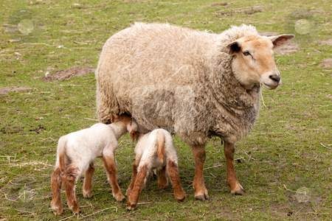

Prolificacy
Ability to produce multiple offspring

Slide 12
Breeds

Slide 13
Fine Wool

Slide 14
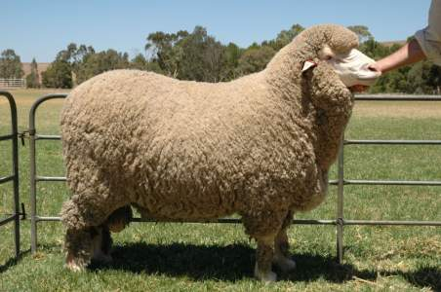
Merino
Originated in Spain
Most dominant breed in the worldwide sheep industry
Typically smaller than other wool breeds
White faced breed

Slide 15
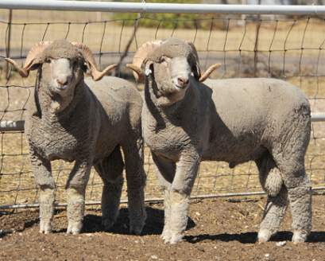
Rambouillet
Originated in France
Dominant range ewe in the western United States
White-faced breed that is not extremely prolific under range conditions

Slide 16
Crossbred Wool

Slide 17
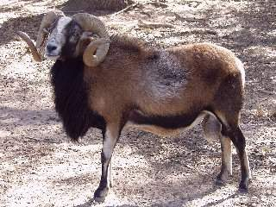
Barbado
Developed in Texas
Cross of Barbados Blackbelly and Rambouillet
Tan, tan with a pale or black belly, or pied
Primarily used as trophy game due to its large curled horns

Slide 18
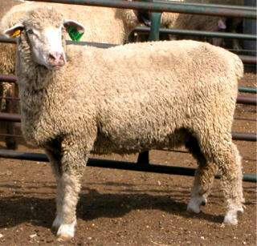
Columbia
Developed in the United States
Foundation of Lincoln rams on Rambouillet ewes
Largest of the crossbred breeds
White faced, polled breed

Slide 19
Medium Wool (Meat Breeds)

Slide 20
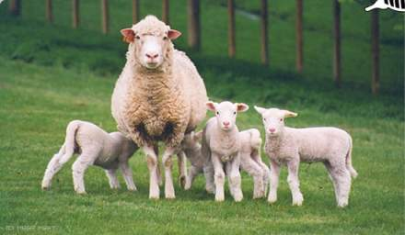
Dorset
Originated in England
Horned and polled strains
Ability to breed out of season
White-faced sheep that produce a light shearing, open fleece

Slide 21
Hampshire
Originated in England
Rapid growth and muscularity
Dark brown to black face and legs with a wool cap on head

Slide 22
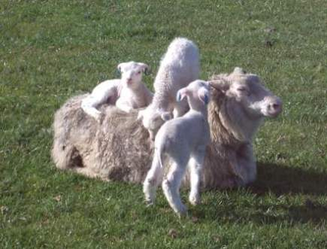
Finnsheep
Originated in Finland
Most noted for their incredible prolificacy (mature ewes produce 3+ lambs)
Very poor fleeces and are slow growing and light muscled
Require intensive management

Slide 23
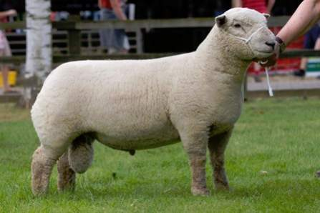
Southdown
Originated in England
One of the oldest sheep breeds
Medium to small sized with light brown face and legs
Produce meaty, light weight carcasses
Low maintenance breed

Slide 24
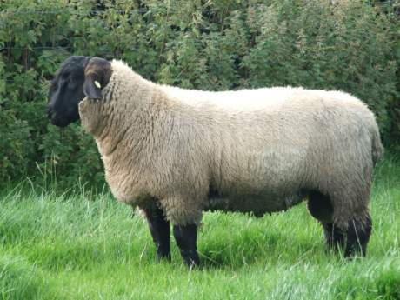
Suffolk
Originated in England
Black head and legs which are free of wool
Alert, active sheep that grow very fast and produce lean, muscular carcasses

Slide 25
Long Wool

Slide 26
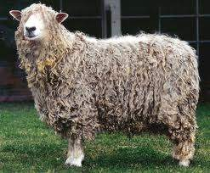

Lincoln
Originated in England
Heaviest breed in the world
Face, ears, and legs are covered with wool
White faced and polled

Slide 27
Management Practices

Slide 28
Methods of Identification
Ear Tags
Tattoos
Ear notching
Neck chains or straps

Slide 29
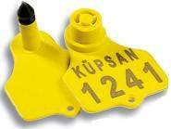
Ear Tags
Most common identification method
Come in many different sizes and designs

Slide 30
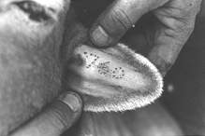
Tattoo
Best permanent form of identification
Does not harm the animal’s appearance or reduce value in any way
Disadvantage: tattoos cannot be read from a distance

Slide 31
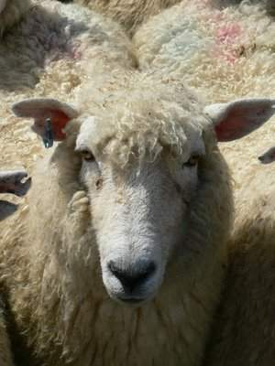
Ear notching
Commonly used for simple differentiation.
Denotes birth type and/or week of birth.
Marks ewes for culling.

Slide 32
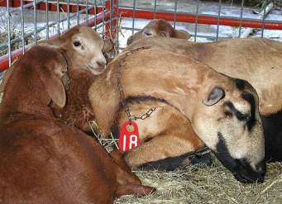
Neck Chains or Straps
Least used form of identification
Have numbered tags that correspond with animal identification
Disadvantages: choking, not permanent, difficult to see in groups

Slide 33
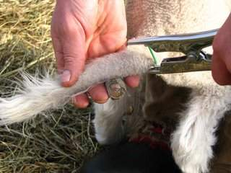
Docking and Castration
Best performed at the same time.
All lambs should be docked before 2 weeks of age.
Males that will not be used for breeding should be castrated before 4 weeks of age.
Docking methods: knife, elastrator, emasculator, Hot iron
Castration methods: Knife, Elastrator, Burdizzo, All-in-one Castrator

Slide 34
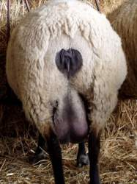
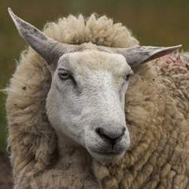
Crutching and Facing
Crutching: shearing of the reproductive area and mammary system of ewes prior to parturition.
Facing: shearing of wool on face to help with vision

Slide 35
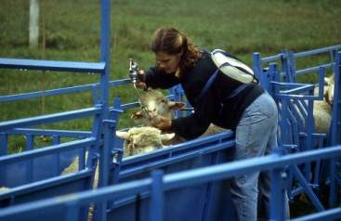
Drenching and spraying
Drenching: administration of oral anthelmintic (dewormer)
Spraying: topical removal of external parasites

Slide 36
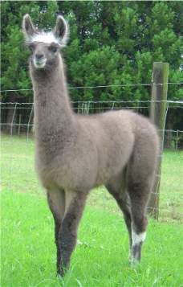
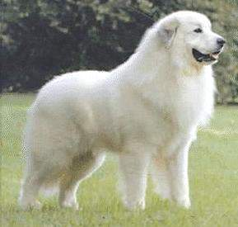
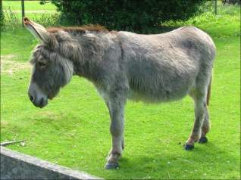
Predator Control
In addition to secure pens, some companion animals serve as effective protection
  Flock dogs such as the Great Pyrenees, llamas, and donkeys

Slide 37
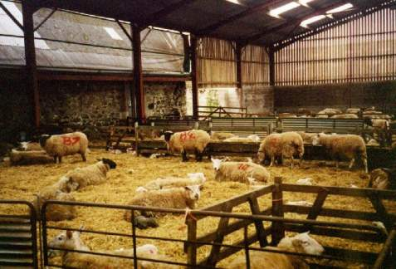
Facilities
200 square feet per lamb recommended
Overcrowding may cause lambs pick at each others wool resulting in bald patches.
Facilities should provide protection from extremes in weather conditions

Slide 38
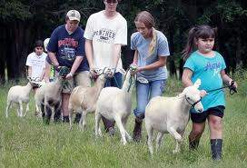
Exercise
Exercising a lamb provides multiple benefits:
  Development of muscle
  Condition or feel of muscle
  Stimulation of appetite
  Proper finish or fat cover

Slide 39
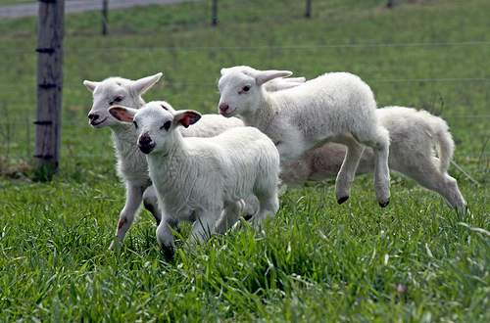
Exercise
Walking lambs on halter on level ground does not give them enough exercise to tone muscle.
If lambs have a large area for exercise during the entire feeding program they may not need a forced exercise program

Slide 40

show Needs
  Rake
  Shovel
  Trimming table measuring 45” long, 20” wide & 18” tall
  Clippers
  Wool card
  Stiff brush for cleaning troughs
  Rope halter
  Hand shears
  Portable feed & water troughs
  Lamb blankets and/or socks

Slide 41
Feeding and Nutrition

Slide 42
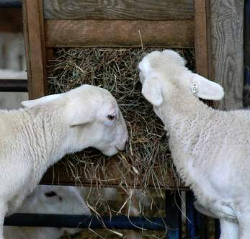
Feeding
Elevate feeders to reduce waste and improve cleanliness
Feed to aid in the development of leg and loin muscle.
Feed good quality grass, sorghum, or alfalfa hay

Slide 43
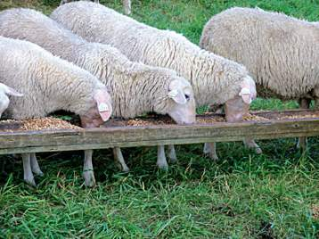
Feeding Continued
Start feeding grain in small amounts to allow the digestive system to adjust to the higher concentrations.
  about ¼ to ½ pound of grain per day
Increase feed gradually to approximately 2 pounds of grain and 2 pounds of hay per day.
  After two weeks lambs should be on full feed.

Slide 44
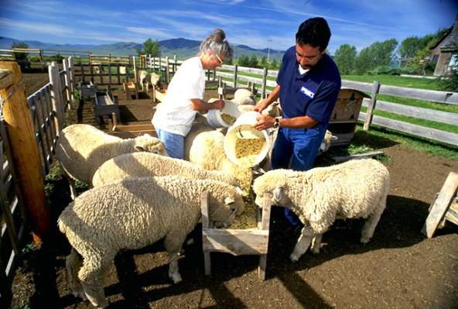
feedIng Schedule
Twice a day, within 15 to 30 minutes of a regular schedule.

Slide 45
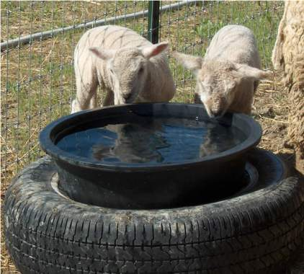
Water
Provide clean, fresh water at all times
The most important nutrient

Slide 46
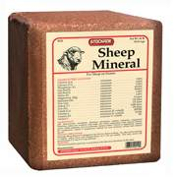

Minerals
Have free choice loose salt, and loose trace minerals available at all times
*Be cautious of the copper level in sheep rations.*
  Accumulate copper in the liver more readily than other farm animals and are very susceptible to Cu toxicity (poisoning)

Slide 47
Animal Behavior

Slide 48
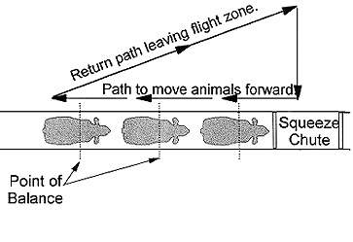
Point of Balance
At the animals shoulder
Stepping behind the point of balance will cause livestock to move forward.
Standing in front of the point of balance will cause livestock to back up

Slide 49
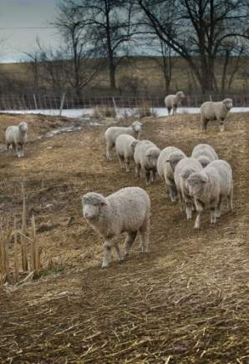
Follow the leader
When one sheep moves, the rest will follow
  To display this flocking behavior a group of five is usually necessary.
This strong flocking and following behavior tends to make sheep easy to handle, relative to other livestock species

Slide 50
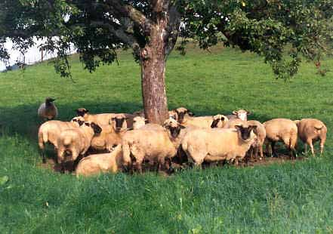
Social
Very social animals; they need to see other sheep

Slide 51
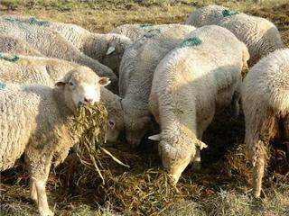
Appetite
Strong indicator for health
Healthy sheep are eager to eat

Slide 52
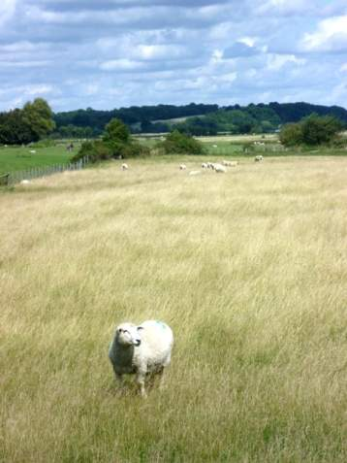
Changes in behavior
May indicate health problems
An isolated animal is likely showing early signs of illness
Lack of appetite is probably the most common symptom exhibited by a sick sheep

Slide 53
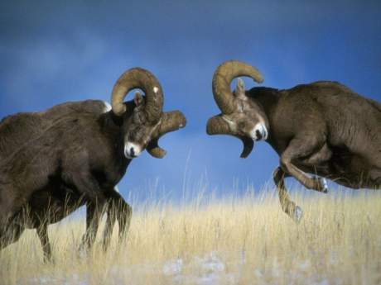
Watch out for rams
Ewes and lambs are generally docile and non-aggressive
  this is not usually the case with rams, especially during the breeding season
A ram should never be trusted, even if it is friendly or was raised as a pet.

Slide 54
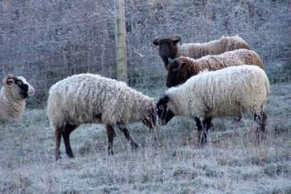

Head butting
Both a natural and learned behavior
Highest during the rutting season which precedes the onset of heat in ewes
To discourage butting, avoid petting or scratching a ram on the head
Ewes may exhibit this behavior after lambing -- to protect their young

Slide 55
Animal Growth and Development

Slide 56
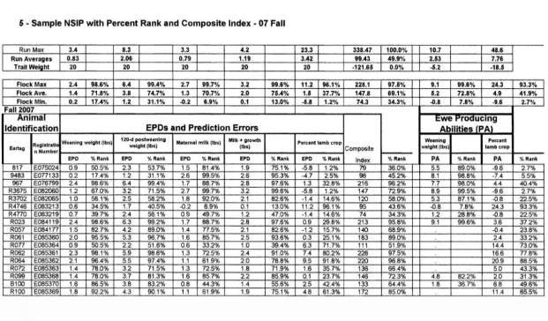
Measures of Growth
Birth weight
60 day weight
90 day weight
Yearling weight
Feedlot AGD
Mature weight

Slide 57
Efficiency of growth
Typically defined as units of feed per unit of gain.
In sheep the feed conversion is 4-6:1 which means it takes 4-6 lbs. of feed to gain 1 lb. of weight.

Slide 58
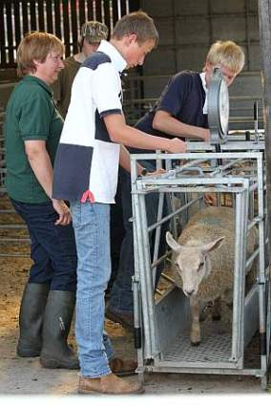
Monitoring growth
Weigh lambs regularly to determine growth.
This will help determine the amount of feed necessary to reach a show weight goal.

Slide 59
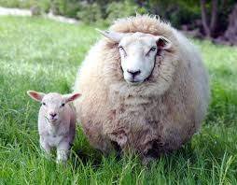
Puberty and Gestation Period
Gestation length: 150 days
Age of puberty
  Rams- 6-8 months
  Ewes- 6-8 months

Slide 60
Animal Health

Slide 61

Medication
Any questions about a lamb’s health program should be addressed by a veterinarian.
Use only medications labeled for sheep and follow all manufacturer recommendations
Be aware of and adhere to withdrawal times

Slide 62
Diseases

Slide 63
Enterotoxemia
(overeating disease)
Inflammation and swelling of the intestines, lungs, and kidneys
Caused by:
  Consuming large amounts of grain
  Compromised immunity
  Heavy parasite infestation
  Conditions or diseases that slow peristalsis

Slide 64
Internal Parasites (worms)
Sheep are more susceptible due to:
  Small fecal pellets disintegrate easily releasing parasites
  Graze close to the ground
  Slow to develop immunity
  Lose immunity during lambing

Slide 65

Parasite control
Pasture management :
  rotation and rest
  low stocking rates
  multi-species grazing
  sanitary measures
Improved nutrition
Proper use of anthelmintics

Slide 66

Sore mouth
Highly contagious virus causing lesions primarily on the lips and nostrils
Zoonotic disease – can be transmitted from animal to human

Slide 67
Tetanus
Common fatal disease caused by the bacterium Clostridium tetani
Sheep are high risk due to maintenance procedures, such as castration, ear-marking, tail-docking, dehorning and debudding
Prevention includes tetanus vaccination and cleanliness

Slide 68

Ringworm
(Club Lamb Fungus)
Thick, scaly pustules on the skin caused by a fungus
Show lambs are more susceptible
  Frequent washings and shearings remove the protective lanolin barrier
Zoonotic
Prevention through good hygiene

Slide 69
Rectal Prolapse
Protrusion of rectal tissue outside the anus
Requires immediate attention from a veterinarian.
Causes:
  High concentrate feed
  Docking length
  Coughing due to respiratory conditions or dusty feed
  Diarrhea

Slide 70


Polyarthritis
(stiff lamb disease)
Infectious disease effecting lambs 3 weeks- 5 months in age
Lambs are inactive, stiff, depressed, losing weight, and have conjunctivitis
Treated with broad-spectrum antibiotics

Slide 71
Evaluation of Sheep

Slide 72

Areas to evaluate
Muscle - forearm, shoulder, rack, loin, and leg
Fat cover - backbone, ribs, and topline

Slide 73

Balance
Definition-straightness of lines
Overall appearance is uniform

Slide 74
References
http://www.sheep101.info/201/index.html
http://www.sheep101.info/201/behavior.html

