Slide 1
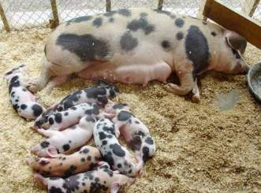
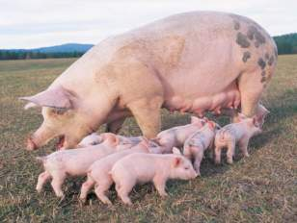
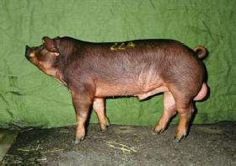

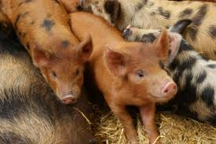
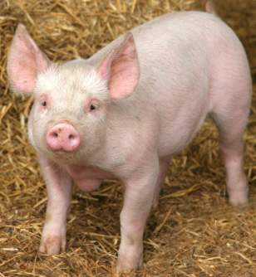
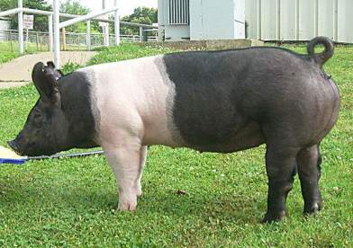
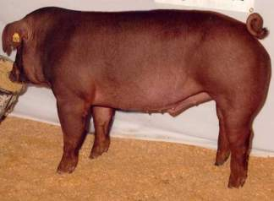
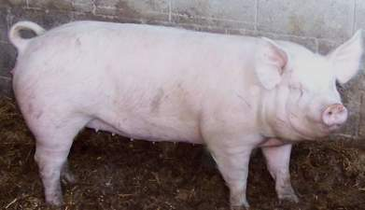
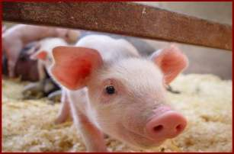

Slide 2
Objectives
Terminology
Breeds
Management Practices
Feeding
Show Preparation
Animal Behavior
Animal Growth and Development
Animal Health
Evaluation

Slide 3
Terminology

Slide 4
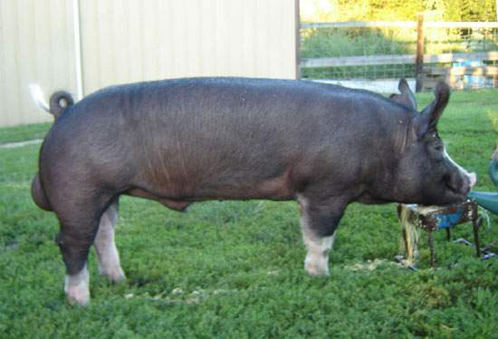
Boar
A male of breeding age
Berkshire

Slide 5
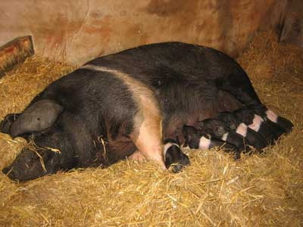
Sow
A mature female that has produced young.
Hampshire

Slide 6
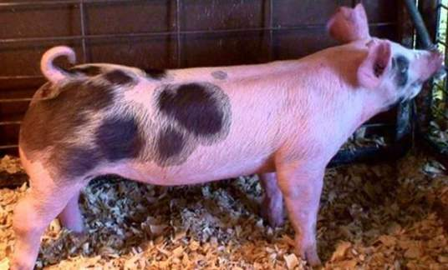
Gilt
An immature female
Spots

Slide 7
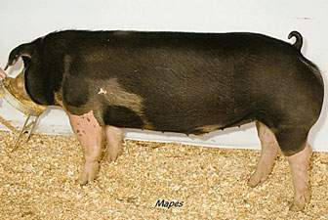
Barrow
A castrated male
Poland China

Slide 8
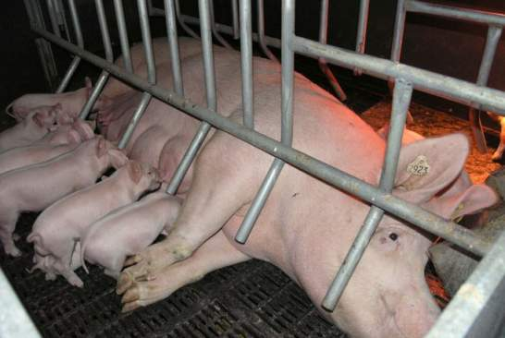
Farrow
Act of giving birth
Yorkshire

Slide 9
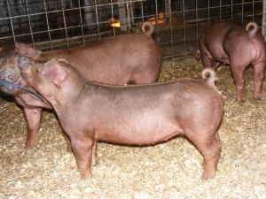
Feeder Pig
A weaned pig ready to finish for slaughter
Pietrain

Slide 10
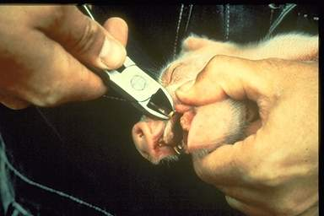
Needle teeth
Set of 8 very sharp teeth in swine that are usually removed from days old piglets to prevent injury to other piglets and sow’s udder.

Slide 11
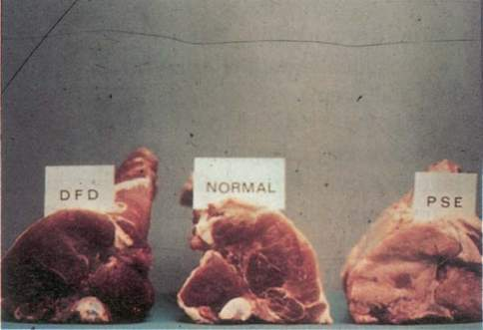
PSE (Pale, Soft, Exudative
Meat characterized by its pale color, lack of firmness, and fluid (exudate) dripping from its cut surfaces.
Back to Objectives

Slide 12
Breeds

Slide 13
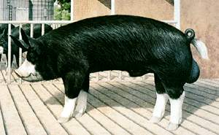
Berkshire
Originated in England
Black color, white points and nose
Short faced with erect ears
Early-maturing
Juicy, flavorful, tender meat

Slide 14
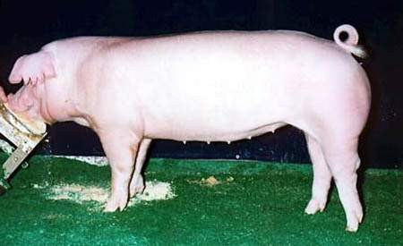
Chester White
Developed in the United States
White with drooping ears
Large litters and excellent mothering ability

Slide 15
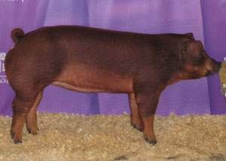
Duroc
Developed in the United States
Reddish brown in color
Drooping ears
Quick muscle growth
Aggressive

Slide 16
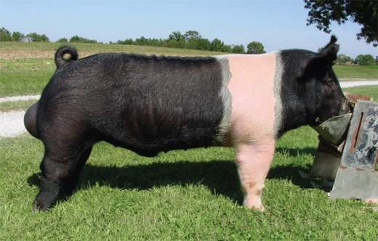
Hampshire
Developed in the United States
Black with a white belt and erect ears
Well-muscled, rapid growers
Excellent mothers
Good tempered
Good carcass quality

Slide 17
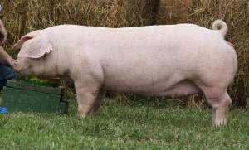
Landrace
Originated in Denmark
White in color with huge drooping ears
Longer than other breeds because of extra vertebrae
More confinement adaptable

Slide 18
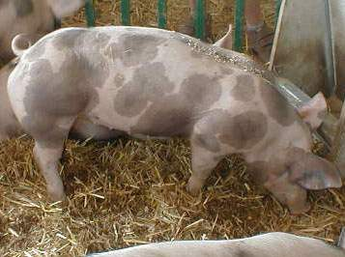
Pietrain
Originated in Belgium
Black and white spotted with erect ears
High proportion of lean to fat
Often carries the gene for Porcine Stress Syndrome
  Purebreds rare, instead used in crossbreeding programs

Slide 19
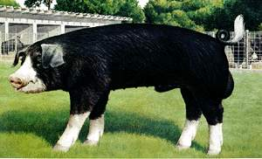
Poland China
Developed in the United States
Black with white patches, drooping ears, and large size
Maximum weight at any given age
Excellent feeders – gain readily
Quiet nature and hardy constitution

Slide 20
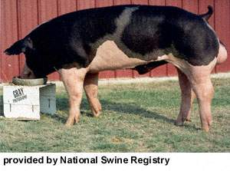
Spotted Swine
Developed in the United States
Black and white spotted with drooping ears
Able to transmit their fast-gaining, feed efficient, meat qualities to their offspring

Slide 21
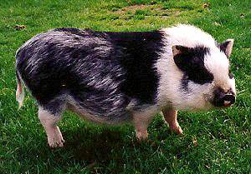
Vietnamese potbelly
Developed in Vietnam
Average 3-ft long, 15-inches tall, and 70 – 150 lbs
Solid black to solid white with a variety of spots
Used as pets

Slide 22
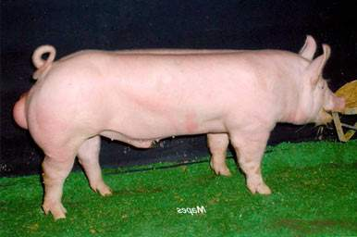
Yorkshire
Originated in England
White with erect ears
“Mother breed”- large litters and excellent milking, and mothering ability
Muscular with high proportion of lean meat
Back to Objectives

Slide 23
Management Practices

Slide 24
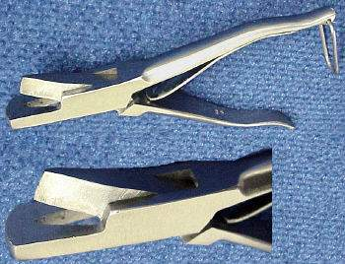
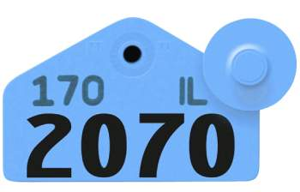
Methods of Identification
Ear notching
Ear tags
Ear tattooing

Slide 25
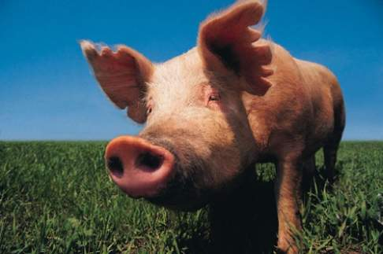
Ear Notches
Method of permanent identification
Pigs are ear notched using a special type of pliers that leave a V shape in their ear.

Slide 26
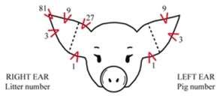
Ear Notching
Depicts both a litter and individual number.
Litter number is placed in the right ear
Pig number placed in the left ear

Slide 27
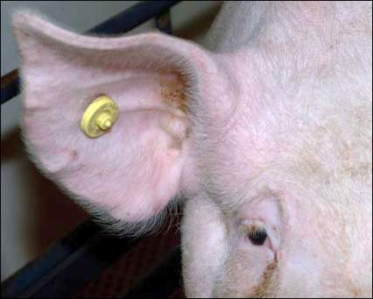
Ear tags
Easily read identification
Usually used once you have selected which pigs you will keep.
Available in different shapes

Slide 28
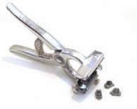
Ear tattooing
Another form of permanent identification
The thinner part of the lower ear is most suitable for tattooing.

Slide 29
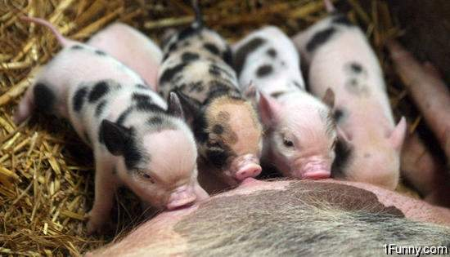
Processing piglets
Recommended 1-4 days post weaning.
The steps of processing are:
  Clip needle teeth
  Cut navel cord
  Iron injection
  Dock tails
  Castrate males
  Ear notch

Slide 30
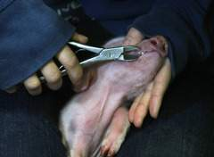
Clip needle teeth
Piglets have 8 needle teeth located on the sides of upper and low jaws
Clipped to prevent biting of littermates or the sows udder

Slide 31
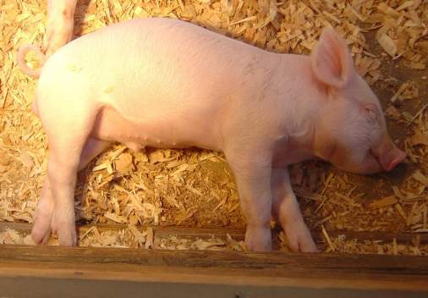
Cut navel cord
Cut to approximately 1 to 1 ½ inches in length and dipped in iodine solution.

Slide 32
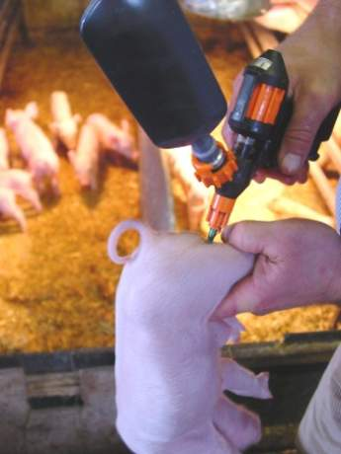
Iron injections
Given to prevent anemia which can result due to the low iron content of milk.

Slide 33
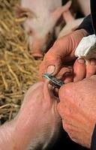
Dock tails
Cut to about 1 inch with side cutters
Prevents tail biting and cannibalism by pen mates and possible infection of tail or spinal cord

Slide 34
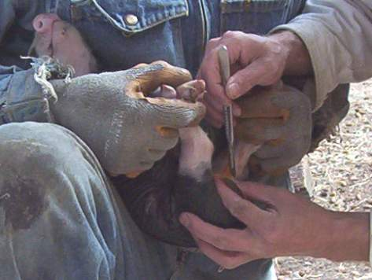
Castration
Performed on male market hogs to prevent undesirable boar odor or taint associated with cooked pork from intact males

Slide 35
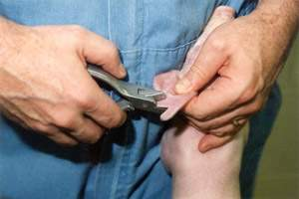
Ear Notching
Identifies which litter pigs came from and so determine reproductive ability of sows.
Identifies individual pigs

Slide 36
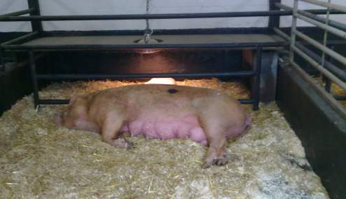
Farrowing
Sows moved into farrowing crates or pens one week before farrowing date.
Once farrowing begins, piglets should be delivered in 15-20 minute intervals
Piglets average 2.5 - 4 lbs.

Slide 37
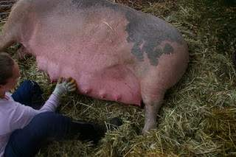
Indications of Farrowing
Restlessness
Swelling of vulva
Fullness of udder
Milk letdown
Fluids present from vulva

Slide 38
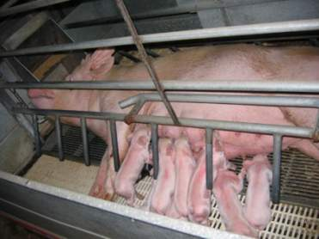
Farrowing Facilities
Clean, dry, and draft-free
Temperature of 65°F to 75°F with supplemental zone heat for piglets
Guardrails about 6” from pen wall and 8” up from floor to prevent crushing
Crates to restrict the sow - typically 5’ wide and 7’ long
Back to Objectives

Slide 39
Feeding

Slide 40
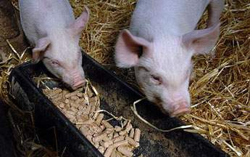
feeding program
Must balance cost and nutrient requirements
Feed according to the requirements of the animal’s stage of development
Some factors affecting nutrient requirements:
  Quality of the diet: energy, by-products, molds, etc…
  Breed, sex, and genetics of pigs
  Stage of development of pig
  Amount of time to finish pig

Slide 41
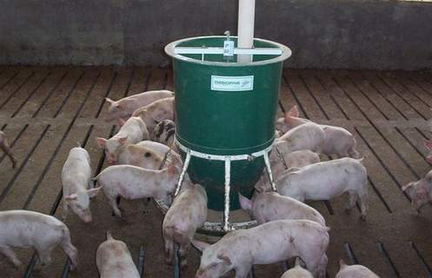
Feeding Practices
Self feeders allows young pigs to feed at will
Environmental temperature can affect appetite
  Ideal temperature is 60 to 70° F.
  Wetting pigs down on hot days will cool them off and improve appetite

Slide 42
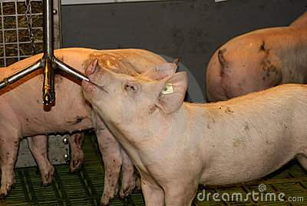
Water
Water is the most essential nutrient required by a pig
Always provide fresh, clean water
If pigs are kept outdoors, haul warm water to them during cold weather
Back to Objectives

Slide 43
Show preparation

Slide 44
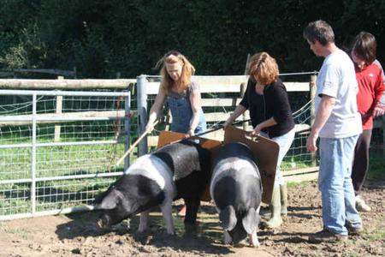
Handling pigs
Move slowly and deliberately when driving pigs
Spend time with the pig to help it adjust to human interaction
Practice show ring activities at home and again upon arrival to a show.

Slide 45
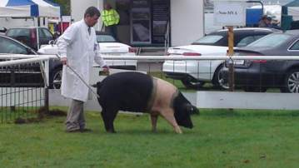
Exercise
Begin exercising pigs two months before a show
Pigs do not sweat.
  Use caution when exercising to prevent overheating
Use a whip or livestock cane to teach pigs to respond to commands such as turning.
  Do not strike on the ham or hip this will cause the pig to arch it’s back and look unnatural.
  Use gentle taps around the head

Slide 46
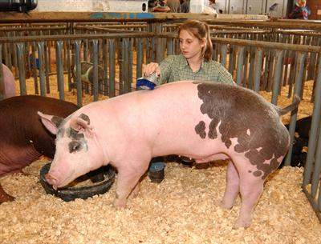
equipment
garden hose (to wash pig)
rubber boots
small brush that fits in the pocket of your pants
scrub brush
mild soap
clippers
cane
rags (to wash out ears and wipe off feet)
water bucket and feed pan
Back to Objectives

Slide 47
Animal Behavior

Slide 48
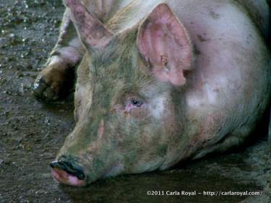
Development of Behavior
Genetics and experience determines how an animal behaves
Some pigs are genetic carriers of a porcine stress gene(PSS)
  This can cause increased excitability and nervousness
  Can even lead to death due to extreme stress

Slide 49

Intelligence
Pigs are intelligent and curious
They learn quickly and respond well to positive reinforcement.
  It is important to make new experiences positive

Slide 50

Behavior
Pigs frighten easily to unfamiliar sights, smells, and sounds
Sensitive to sharp contrast
  A pig may balk if it sees shadows, puddles, bright spots, change in flooring type or texture, or drains

Slide 51

Social Hierarchy
The social organization established when unacquainted pigs are initially mixed together
They fight by mouth-to-neck attacks with strong thrusts sideways and upwards, to establish a dominance hierarchy
Hierarchy typically established within 24 hours
  Aggression drops dramatically after about one hour

Slide 52

Rooting
“Rooting” is when the pig tucks its head and uses its snout to push up whatever it comes in contact with.
Natural as opposed to learned behavior

Slide 53


Temperature Regulation
Mature pigs are susceptible to hot conditions
  Seek shade and wallow in mud or water
  more active at night
  Build nests to provide shelter from environmental extremes.
Young pigs are sensitive to cold
  huddle with littermates -
Back to Objectives

Slide 54
Animal Growth and Development

Slide 55

Measures of growth
Birth weight
Weaning weight
Days to 270-280 lbs

Slide 56

Efficiency of growth
Defined as units of feed per unit of gain
In swine, the feed conversion is 3.5:1
  Every 3.5 lbs. of feed should result in one pound of gain.

Slide 57

Puberty and Gestation period
Puberty: 5-8 months of age
Gestation length: 110-120 days (114 average)
Back to Objectives

Slide 58
Animal Health

Slide 59
Diseases

Slide 60

Swine Dysentery (Scours)
Body system affected: gastrointestinal
Cause: bacteria
Type of swine affected: 8-14 weeks old
Treatment: antibiotics, sanitation
Symptoms: slows growth of pig; loose, frequent, off-colored feces; lethargy; dehydration

Slide 61

Actinobacillus
(Haemophilus Pneumonia)
Body system affected: respiratory
Cause: bacteria
Type of swine affected: growing-finishing swine
Treatment: antibiotics
Prevention: Vaccine
Symptoms: abdominal breathing, high fever, sudden death

Slide 62
Leptospirosis
Body system affected: reproductive
Cause: bacteria
Type of Swine affected: boars and sows
Prevention: vaccination program
Symptoms: results in abortion and stillbirths
Transmissible to humans

Slide 63

Porcine Reproductive and Respiratory Syndrome
Body system affected: reproductive and respiratory
Cause: virus
Type of swine affected: all
Symptoms: birth of premature litters; stillborns; increased preweaning illness in piglets; respiratory disease in the nursery

Slide 64
Porcine Stress Syndrome(PSS)
Body system affected: nervous
Cause: genetic
Symptoms/signs: the onset is sudden with muscle tremors, twitching of the face and rapid respiration, skin becomes red and blotched.
Treatment: ineffective
Prevention: cull animals that carry the gene

Slide 65
PSS Cont’d
Presence of the porcine stress gene in the show pig industry is one of the contributors to “dead or downer” pigs and poor pork quality.
Stress positive pigs exhibit extreme nervousness and excitability when exposed to stressful situations resulting in PSE pork and increased death loss.
Show pig producers should use animals that are stress gene negative (NN) to prevent these problems.

Slide 66


Parasites
Common Types: Mange, Lice, Roundworms, Threadworms, and Nodular worms
Causes: lack of sanitation
Treatment: spraying with insecticides for mange and lice use of deworming agents on worms
Symptoms: presence of the parasite on the hair or in the feces, loss of hair and scaling of skin, reduced performance.
Back to Objectives

Slide 67
Evaluation

Slide 68

Areas to evaluate
Muscle: forearm, shoulder, top, loin, rump, ham
Fat cover: jowls, behind the shoulder, over the top, rear and fore flanks and underline

Slide 69

Soundness
Pig should grow, develop, and move correctly
Front legs are straight when viewed from the front
Toes should point straight forward and each toe should be the same size
Rear legs should be straight when viewed from the rear of the pig

Slide 70

Muscle
Wider through the center and lower part of the ham than the top (rump) part.
The loin should be wide with a deep groove down the center and rounded on the edges (butterfly shape).
Wide in the shoulders and chest floor

Slide 71

Frame Size
Refers to the skeletal size of the pig
Should have a long neck, tall with long legs, and long body
Long from shoulder to ham.

Slide 72

General appearance
Referred to as “eye appeal”
Pig should appear balanced
Blemishes apparent in a young pig are often magnified in a finished pig
Back to Objectives

Slide 73
References
http://www.dpi.qld.gov.au/27_4705.htm
http://www.thejudgingconnection.com/pdfs/Swine_Nutrition.pdf
http://extension.usu.edu/cyberlivestock/files/uploads/Basic_Show_Pig.pdf
http://ucce.ucdavis.edu/files/filelibrary/2328/18366.pdf
http://ag.arizona.edu/pubs/animal/az1055.pdf
http://www.pork.org/filelibrary/youth/PQA%20youth%20HAN%20LING%20VERSION7.pdf
http://ylsp.bae.ksu.edu/categories/lesson/5
http://dasweb.psu.edu/pdf/4hmarketswine.pdf

